Slide 1
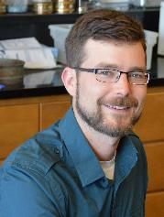



Ocean Bitemap:
A global, collaborative analysis linking biodiversity and
marine predation intensity using standardized methods
Matt
Matt Whalen, Ross Whippo, Emmett Duffy,
and approximately 55 partners (give or take …)
Ross
Smithsonian Institution
Notes:
I will describe the first pass at an effort to map top-down control in the ocean
This has been a broad cvollaborative effort, involving >50 partners
Shout-out to Matt Whalen who is leading this manuscript
Ross Whippo of Smithsonian MG who helped organize and collated the data

Slide 2
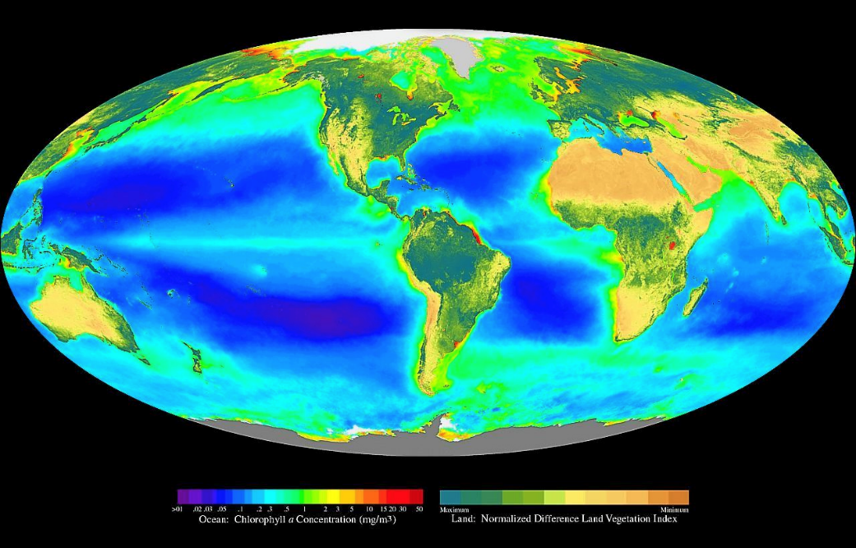

Physics drives the earth and ocean system
Notes:
triumph of oceanography in recent decades: Physics drives the earth and ocean system.
Solar heating sets up large-scale circulation, sets up distribution of nutrients
And ultimately global patterns in ocean productivity
We know how bottom-up forcing works on global scale

Slide 3

We don’t have a map of top-down forcing
Biodiversity
Environment
Ecosystem
function
Notes:
But we don’t have a comparable map of top-down forcing for a good reason
Because top-down forcing comes from a diverse range of animals
And BD is more complicated than temperature

Slide 4
Biodiversity is as important as climate to ecosystems!
versus climate
versus nutrients
Rank importance of diversity
Duffy, J.E., C.M. Godwin, B.J. Cardinale. 2017. Nature 549:261-264.
Notes:
In fact biodiversity comparabley important as climate in explaining patterns of biomass
Based on 67 studies from marine, aquatic, and terrestrial systems (including RLS)
Rank importance of BD to biomass productivity is similar to or greater than climate and nutrients

Slide 5
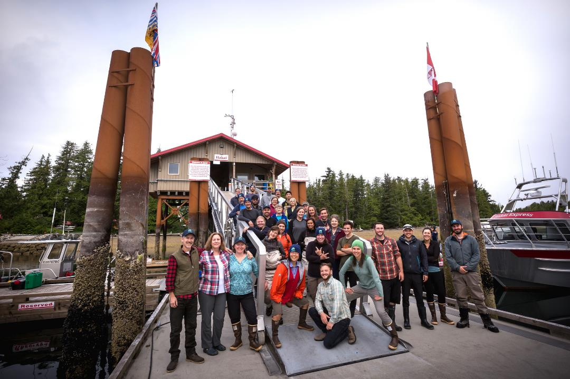

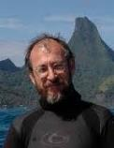

We’re building the library of marine biodiversity
Matt Whalen
Monday 1600,
524C
The 2017 Hakai-
MarineGEO BioBlitz:
A new gold standard
approach to inventorying and understanding marine biodiversity
Gustav Paulay
Wednesday 1030,
524C
Mare incognita - how
little we know about
coastal biodiversity and how to
change that
Notes:
How do we incorporate biodiversity into process-based ecology?
The first step is to know who is there.
MarineGEO is leading intensive biodiversity inventories for this purpose
Collaborating with partners like Hakai Inst in BC
Two talks at this conference about this

Slide 6
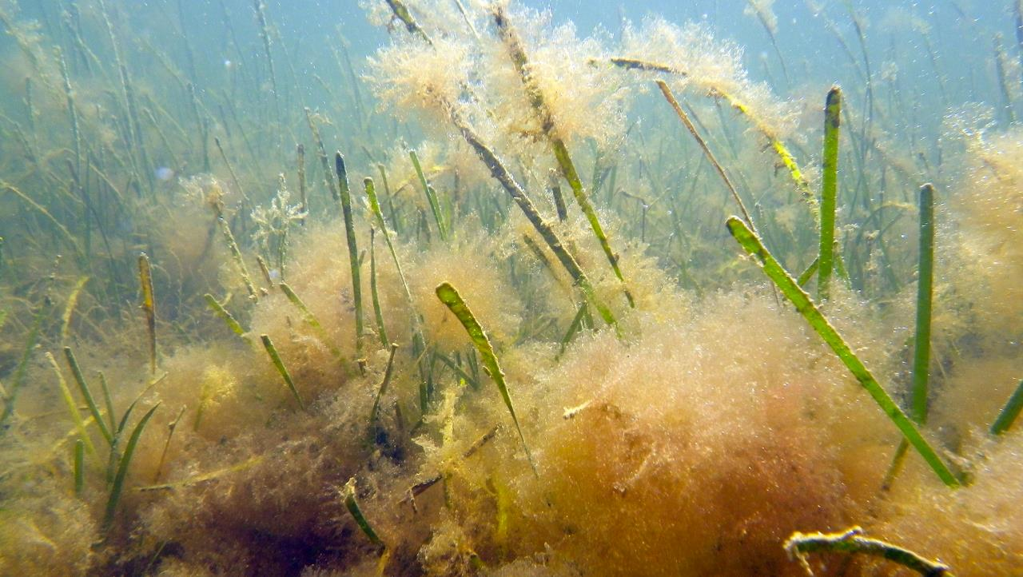
Predation is a fundamental process in ecosystems
Large
predators
Small
predators
Algae
grazers
Seagrasses
Algae
+
Notes:
Why is predation important?
An example is seagrass cover, one of the GOOS essential ocean variables:
Predation > BU transfer of production to fishery harvest
Predation > TD seagrass health (cod > meso > grazers> SG health)

Slide 7
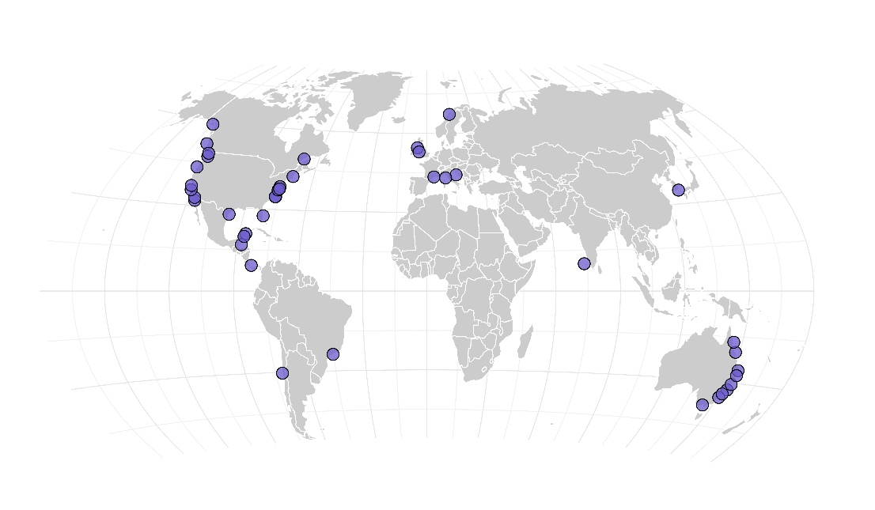

Alaska –W Raymond
Baja California – C Hereu, P Jorgensen
British Columbia – M Hessing-Lewis, Z. Montieth
Belize – D Janiak
Brazil – A Flores
California 1 – K Hovel, M Yeager
California 2 – J O’Leary
California 3 – B Hughes
Chile – M Thiel
Croatia – C Kruschel
Delaware – D Dixon, L Johnston
Florida – D Janiak
France – F Rossi
India – E D’Souza
Ireland – N O’Connor
Italy – L Benedetti-Cecchi, F Bulleri
Korea – K-S Lee
Massachusetts – R Hughes, T Hanley
North Carolina 1 – S Ziegler, J Fodrie
North Carolina 2 – B Silliman, L Gaskins
Norway – K Sieben
New South Wales 1 – A Poore
New South Wales 2 – B Lanham
New South Wales 3 – A Vergés
New South Wales 4 – B Kelaher
Oregon – A Galloway
Ocean Bitemap: a global map of top-down control
Virginia 1 – PG Ross
Virginia 2 – J Lefcheck
Victoria – H Janes
Washington 1 – K Hultgren
Washington 2 – O Graham?
Wales – R Unsworth, M Robinson?
Yucatán 1 – B van Tussenbroek
Yucatán 2 – E Lozano Ílvarez
Panamá – J Seeman
Québec – M Cusson
Queensland 1 – P York
Queensland 2 – C Henderson
Queensland 3 – R Connolly
Queensland 4 – M Rasheed
Texas – M Diskin, L Smee, C Patrick
Notes:
2016: paired seagrass and unvegetated in each of 41 sites, 3 deployments each
Measured Predation an fish communities

Slide 8
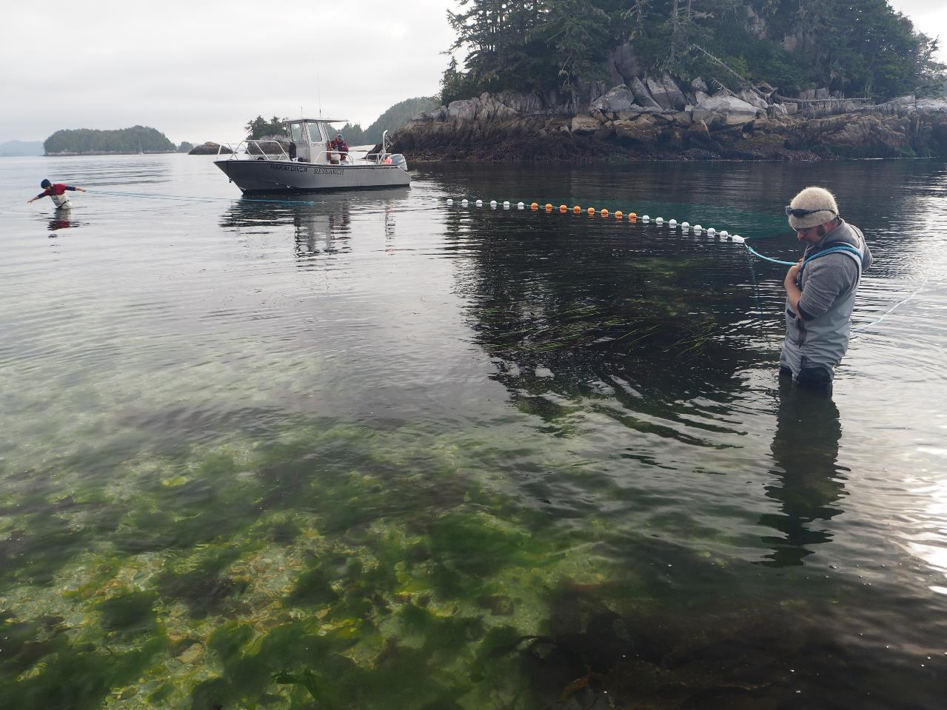
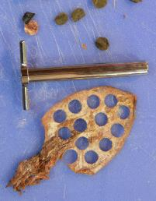
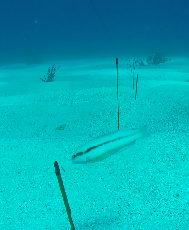
We measured predation & fish communities worldwide
Notes:
41 sites – sampled a pair of seagass and unvegetated sites
Measured predation with squidpops – bait on a stick: simple, cheap, fast
Sampled fish via seine

Slide 9
Notes:
squidpop assay in action
Illustrates multiple factors influencing predation: habitat structure, kinds of spp present

Slide 10
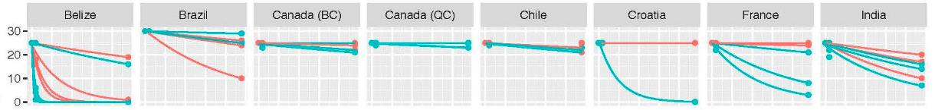
We estimated predation as the exponential decay rate of bait
Bait survival
Exposure time (hours)
Notes:
We measured predation as a rate: exponential decay
Deploy 25 squidpops at a site
Score after 1 hr and 24 hours
Modeled bait loss through time at each site to obtain predation rate

Slide 11

Predation was highest at mid latitudes
Notes:
As expected Predation was low near the poles, but …
It was also low near the equator
followed a Admittedly we have low coverage near the equator

Slide 12
Habitat did not explain much
Predation
Fish biomass
Fish richness
Predation rate (hr⁻¹)
Biomass (g m⁻²)
Fish richness (ENSPIE)
Notes:
First, to our surprise, there were few differences between seagrass and unvegetated
Fish biomass and diversity were slightly higher in seagrass
But no significant AVERAGE difference in predation (this varied among sites)

Slide 13
Predation loss increases with temperature, fish biomass, & richness
Temperature
Fish biomass
Fish diversity
Notes:
First pass shows: predation did not differ between seagrass and unbegetated habitat

Slide 14
Globally, predation rises with temperature, fish biomass, & diversity
Model ΔAIC
Predation ~ temp + log B*richness 0.0
Predation ~ temp + log B + richness 0.5
Predation ~ temp + log B 1.1
Predation ~ temp + richness 3.7
Predation ~ temp (in situ) 4.0
Predation ~ temp + habitat 4.6
Notes:
Modeled results at each site > predation rate
Is biodiversity as important as climate – as I suggested before?
Predation. ~ In situ Temperature + fish biomass + fish richness
Model results: AIC

Slide 15
Globally, predation rises with temperature, fish biomass, & diversity
Water
temperature
**
Fish
biomass
*
Predation
rate
*
Fish
richness
Biomass
x richness
NS
Notes:
Is biodiversity as important as climate – as I suggested before?
The data so far suggest it is: arrow thickness = effect size (scaled coefficient from linear model)
Hint that richness is less important where you have high biomass (red = negative), but not significant

Slide 16
Globally, predation rises with temperature, fish biomass, & diversity
Notes:
As expected, predation rate rises exponentially with temperature,
And more or les linearly with fish biomass
(too busy to plot richness in same graph)

Slide 17

Next: Let’s increase global coverage!
Notes:
We need to increase sample size and global coverage to answer these questions better
And to parameterize more general models of top-down control
Its easy to do, BUT need changes: clear water, hard substrata,
Use GoPros to sample fish – non destructive, no permits required

Slide 18
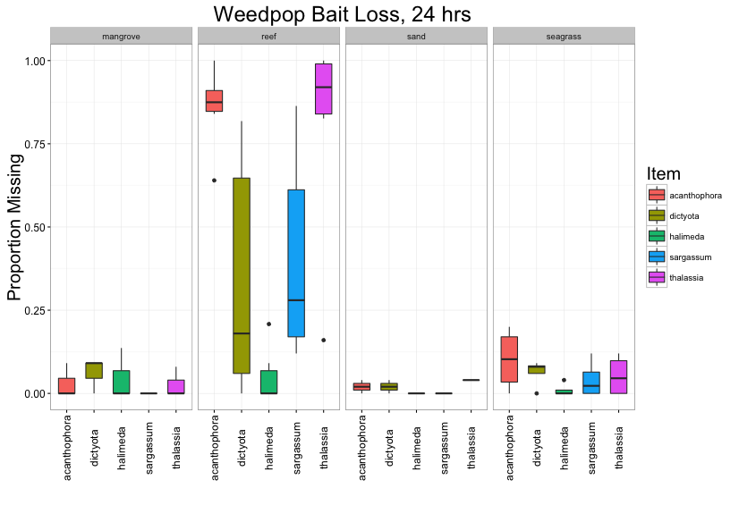
Next: Weedpops!
Mangrove
Reef
Sand
Seagrass
Notes:
We need data on herbivory – key component of eciosystem health on coral reefs and other systems
Another approach n reefs is

Slide 19
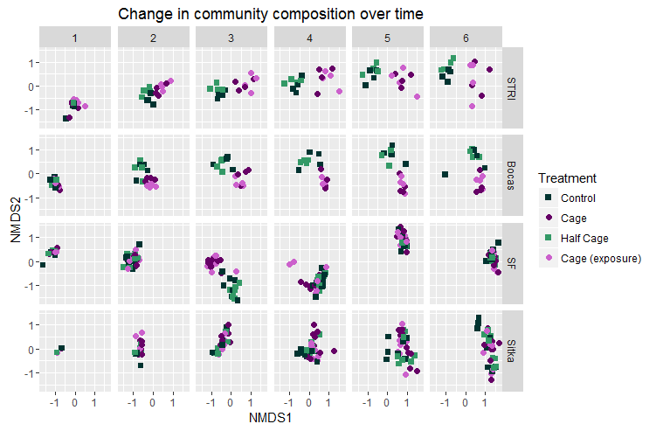
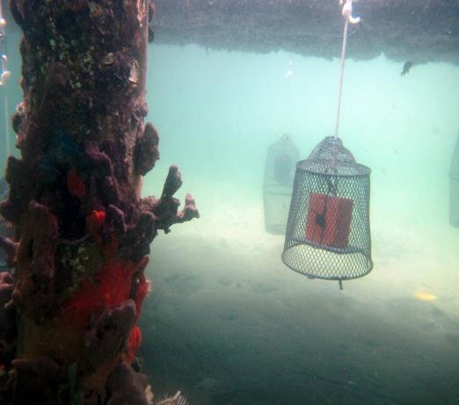
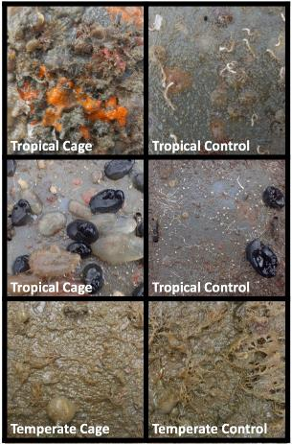
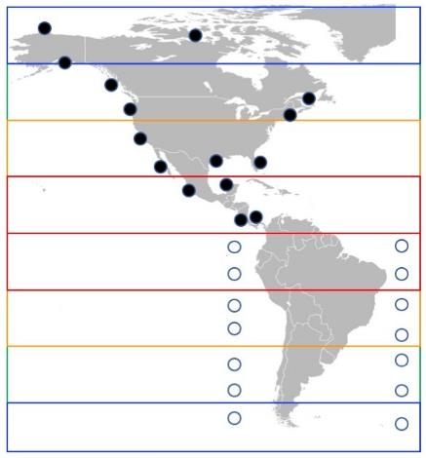
Next: How does predation change communities?
uncaged
caged
Gail Ashton
Notes:
Next steps:
Whata er community-level effects of predatiuon across geography?
Enrique mentioned yesterday, Smithsonian MarineGEO is organizing coordinated experiment
Predator exclusion, effects on fouling community development
Led by Gail Ashton of Smithsonian

Slide 20
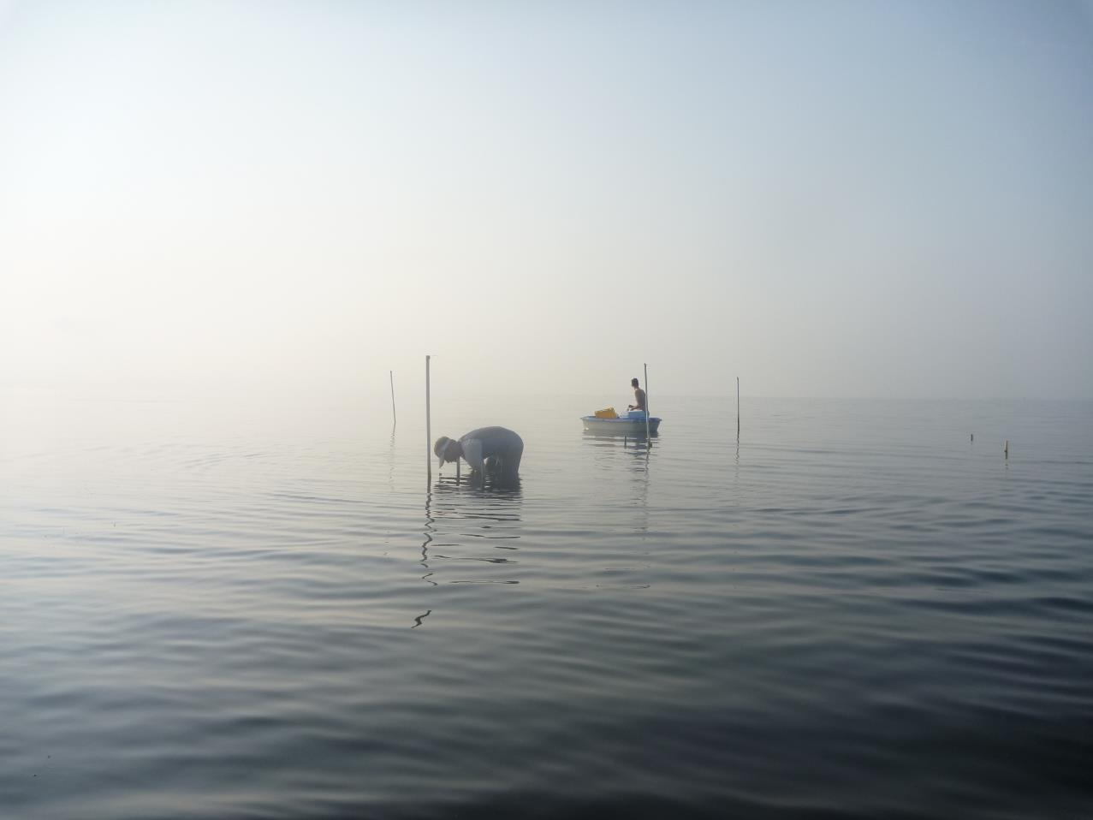
Des questions?

